Slide 1
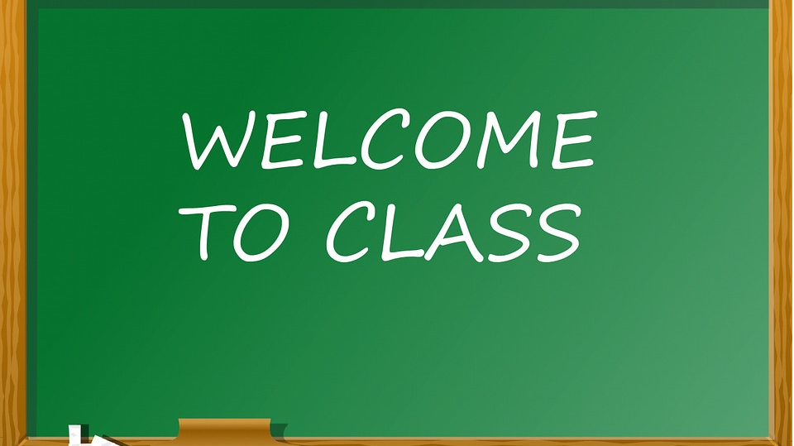
Student Guide: Google Classroom

Slide 2
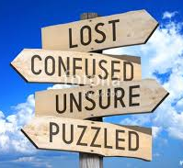
What is Google Classroom?
Kelly • Sept 2017

Slide 3
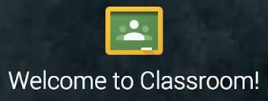
Google Classroom acts as an online classroom
Teachers can handout and collect assignments in the online classroom
Teachers can post assignments, class announcements, calendars, notes and many other items that can help student organization
Students can see assignments on the Work page, in the class stream, or on the class calendar
Teachers can create class discussions that the students can participate in

Slide 4
Let’s Get Started!
…Seeing and Doing is always the best way to learn something new.

Slide 5
Step 1
LOGIN
Go the the Google Classroom website and login with your Google Apps email login and password
Classroom.google.com

Slide 6
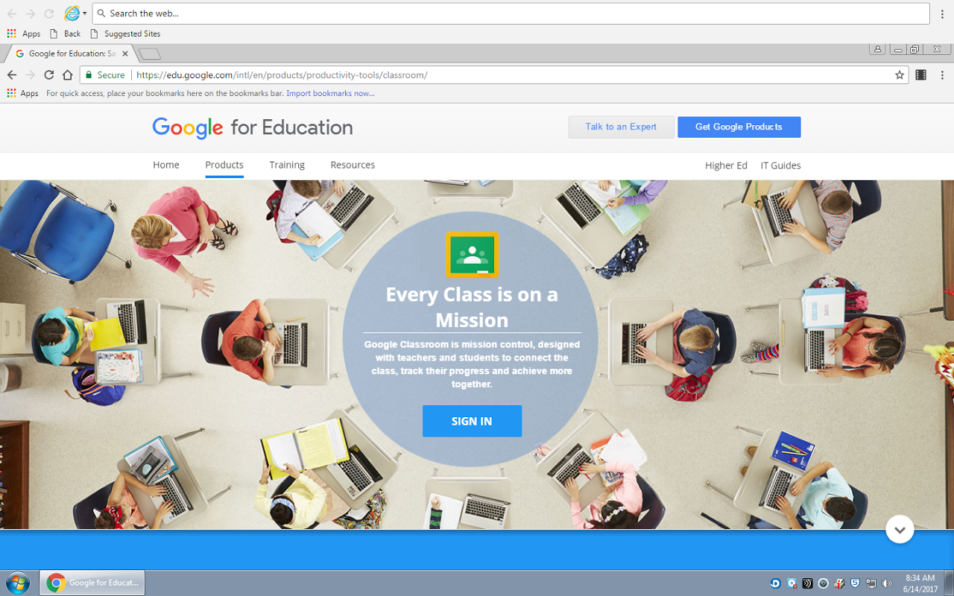

Slide 7
Login:
First Initial + Last Name + @scarsdaleschools.org
Example:
mkelly@scarsdaleschools.org
Password:

Slide 8
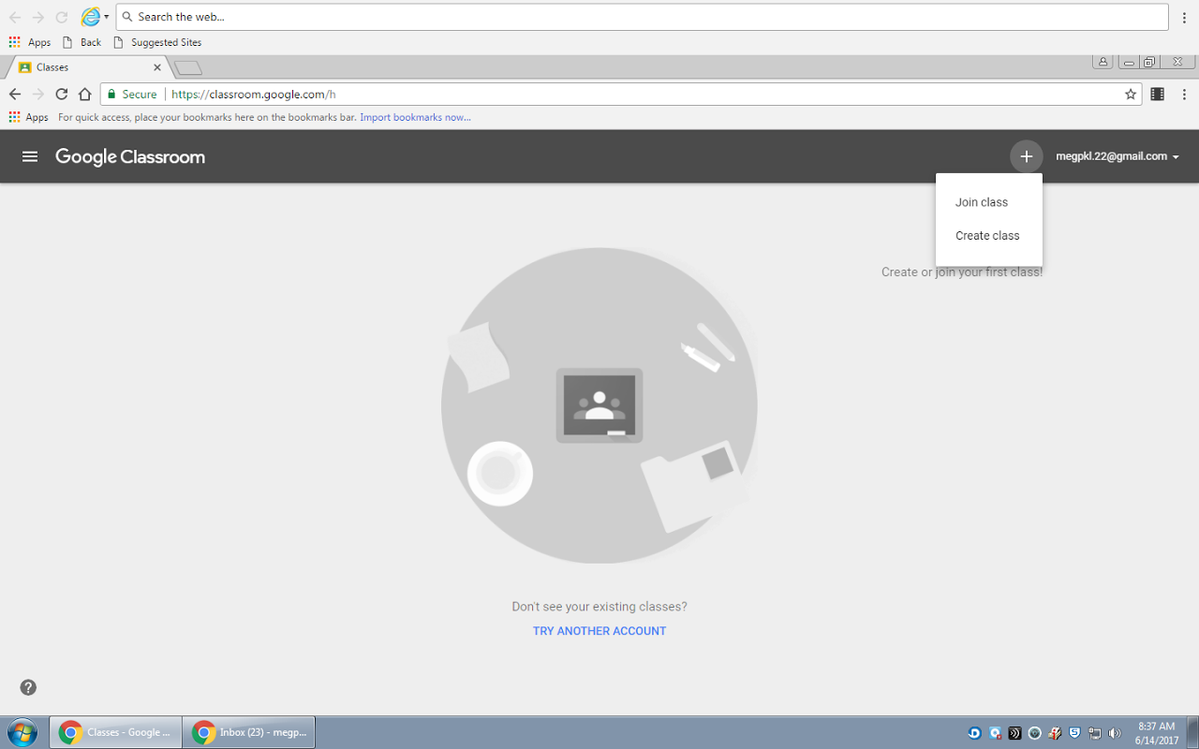
Click the plus sign
Click Join Class

Slide 9
Step 2
JOIN
Enter the class code below to join our class
CLASS CODE
Period 3: y29ajx
Period 4: hd21arw
Period 6: k4vaa29
Period 7: yk1tan

Slide 10
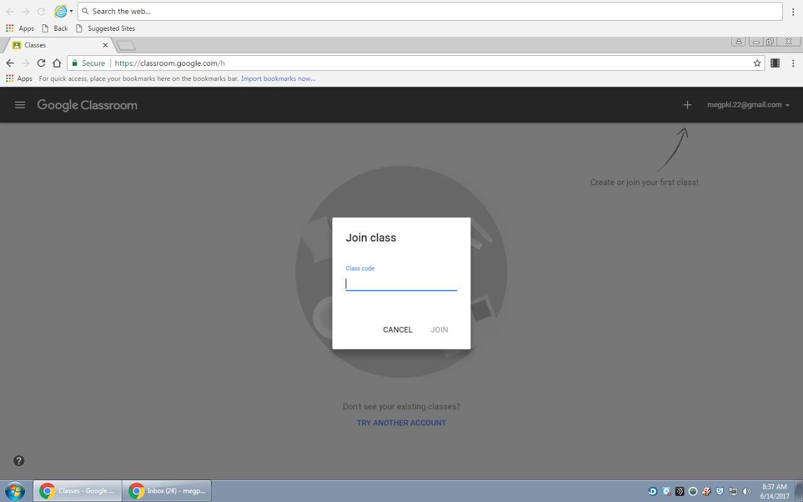
Enter our class code to join:
CODE

Slide 11
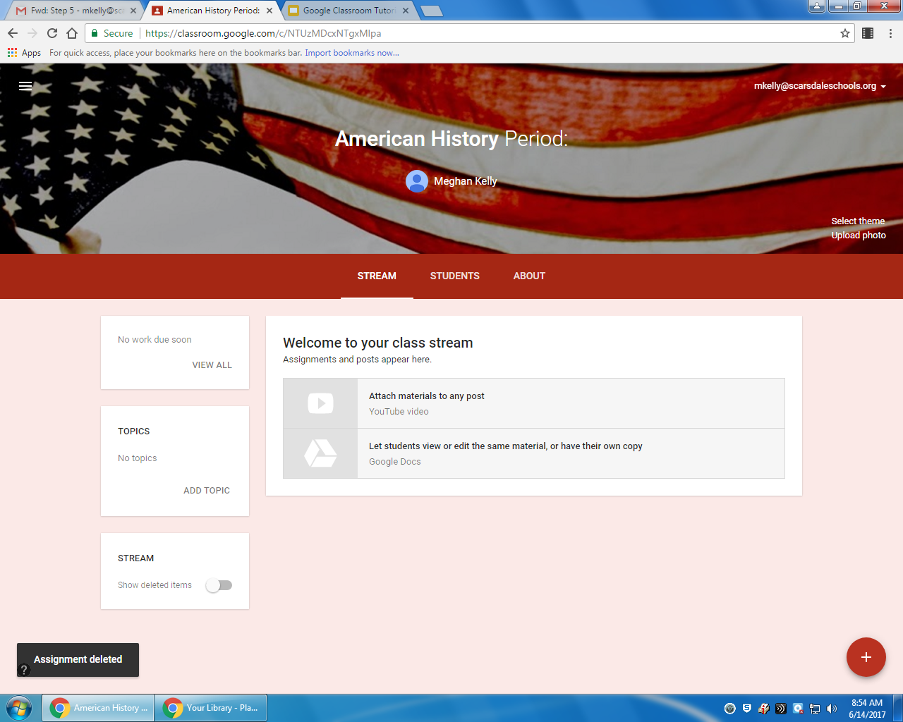
Here’s what our Google Classroom Home screen will look like.
Welcome Home!

Slide 12
Step 3: Student Desktop in Google Classroom
Stream
Classmates
About
There are three main sections that we will use in Google Classroom:

Slide 13
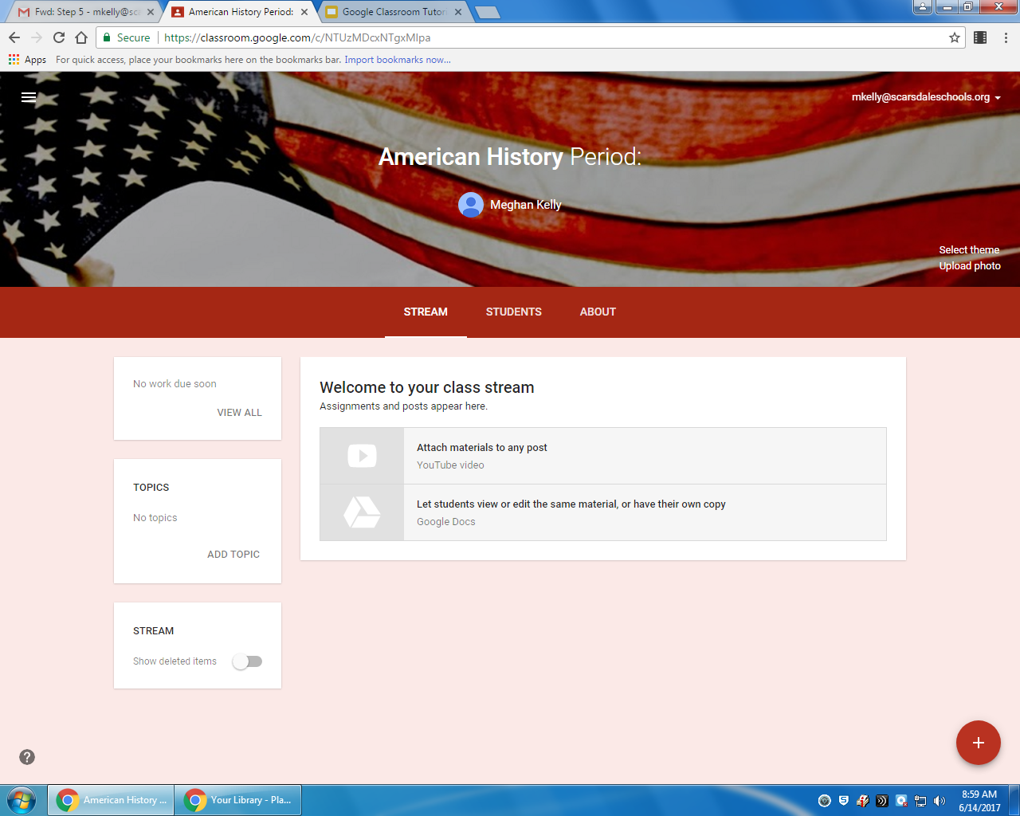
Stream
Work Due
Class Posts
Teacher Announcement

Slide 14
Classmates
View Class list
Email classmates

Slide 15
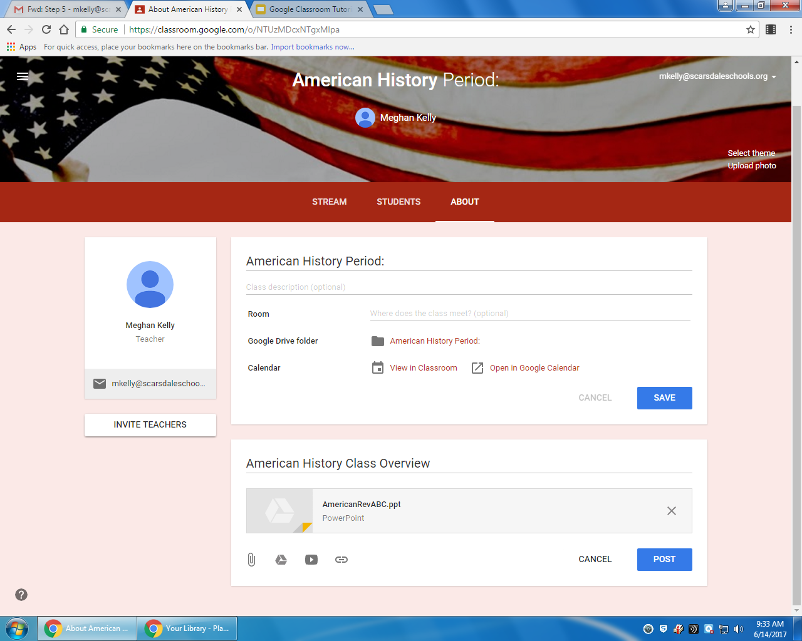
Calendar
Assignment due Dates
Classroom Materials:
Class Syllabus (Overview)
Powerpoint Notes

Slide 16
Step 4
Submit
Learn how to Complete and turn in Assignment

Slide 17
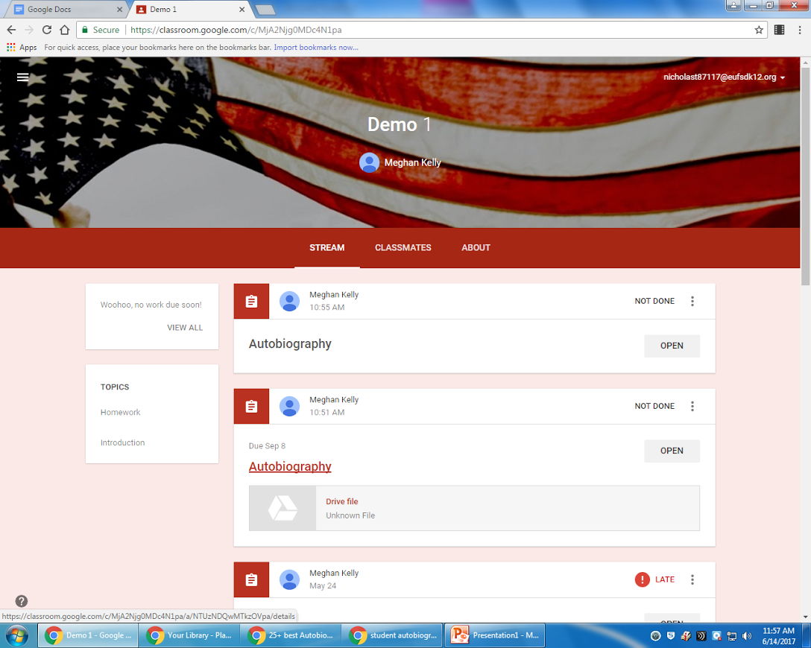
Assignments will be posted under the Stream Tab.
Click on the assignment to open it.

Slide 18
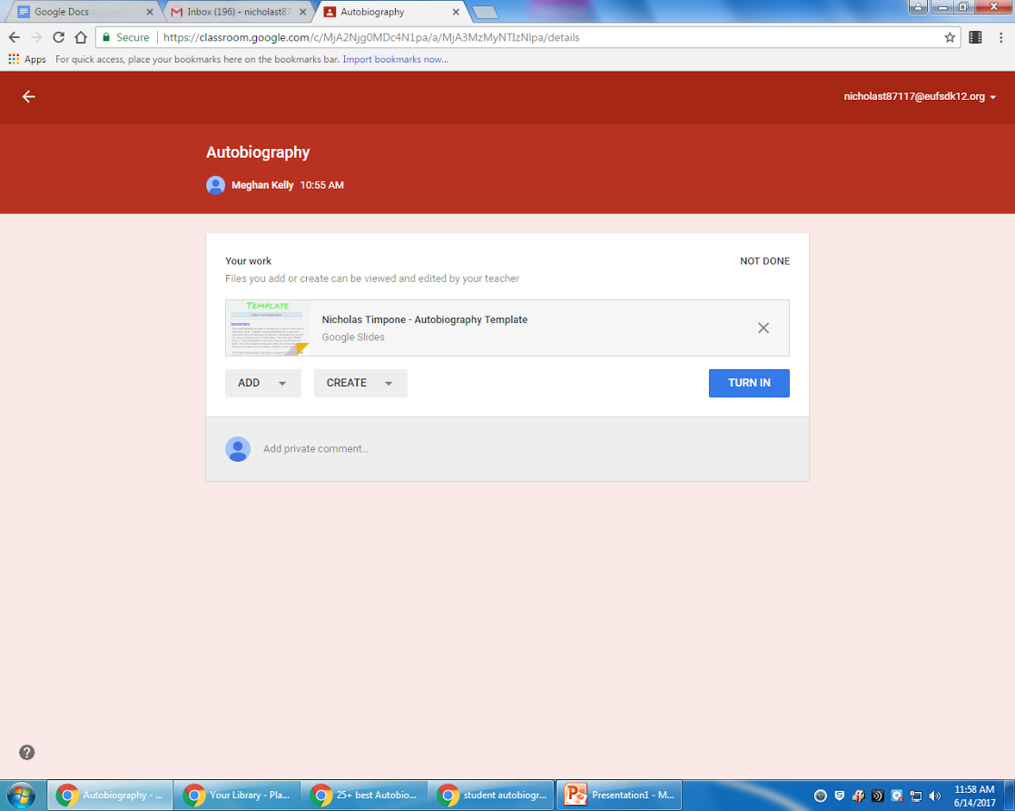
Some assignments will include documents or templates as attachments that you will open and then work on.
Click on the attached document to open it and work on it. It will be automatically saved to your google drive.

Slide 19
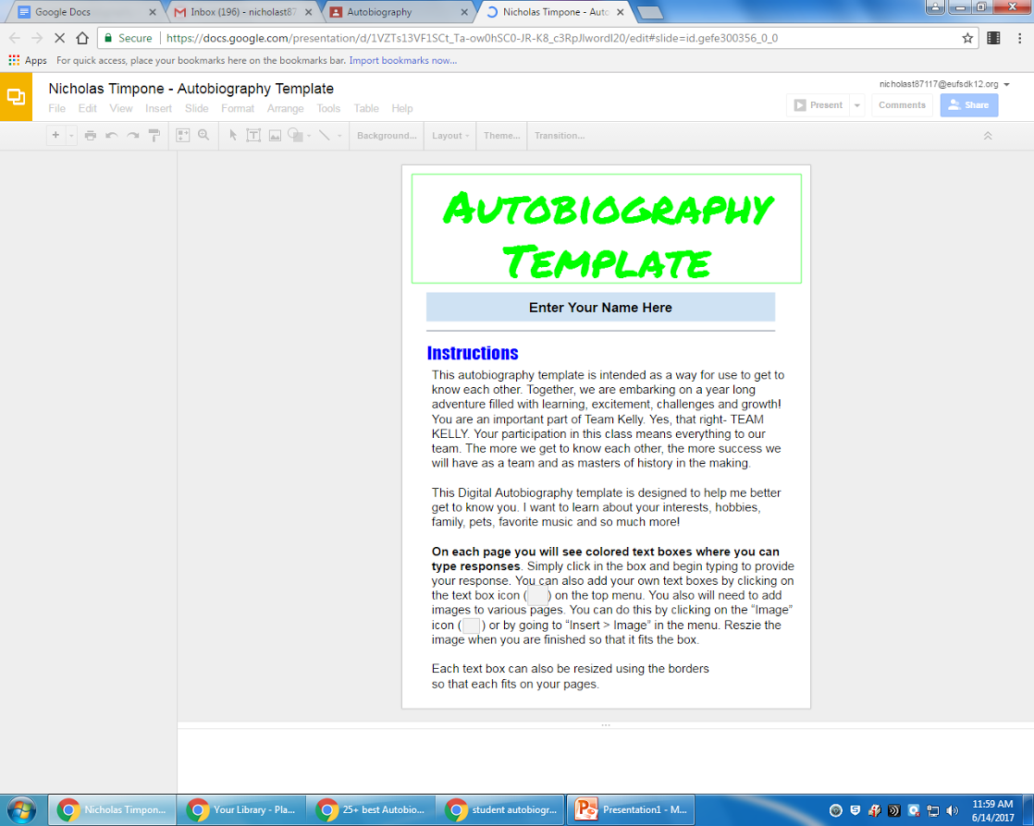
This is an example of an attached document will look like when you open it.
If the assignment is a template, you can work directly on it.
The changes you make to the document will be automatically saved to your google drive.

Slide 20
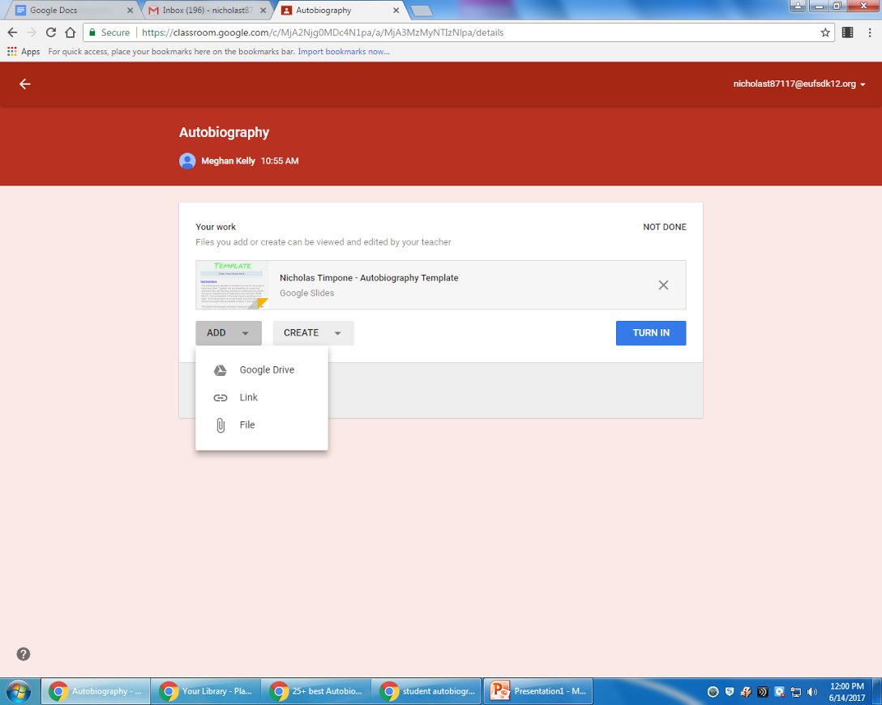
When you want to turn in a document that you have already worked on and it is saved in your google drive click the “ADD” button

Slide 21
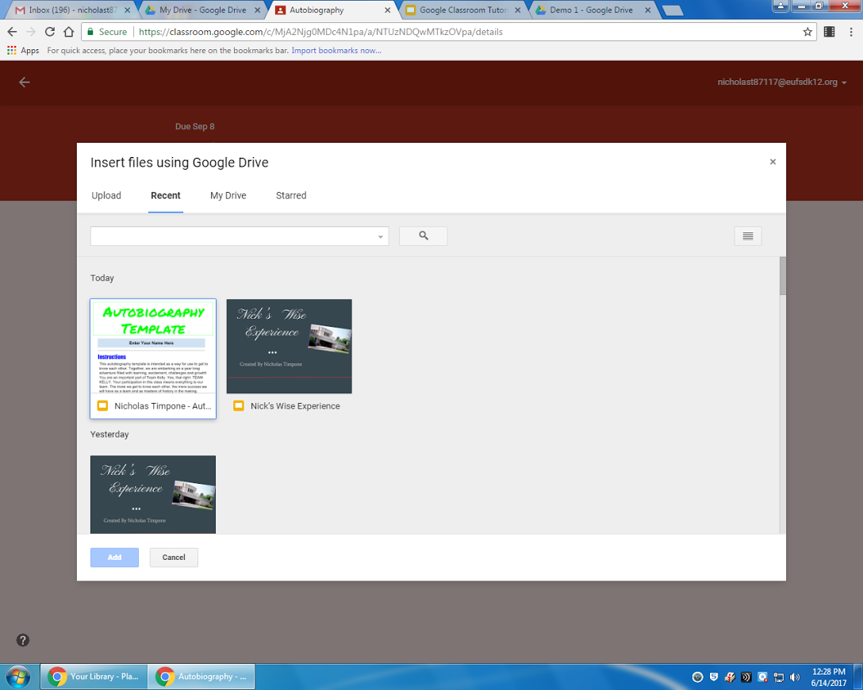
Your google drive will open. You can choose from recent documents or click on the “My Drive” tab to access all of your documents
After you have located the document, select the document and then click “ADD”

Slide 22
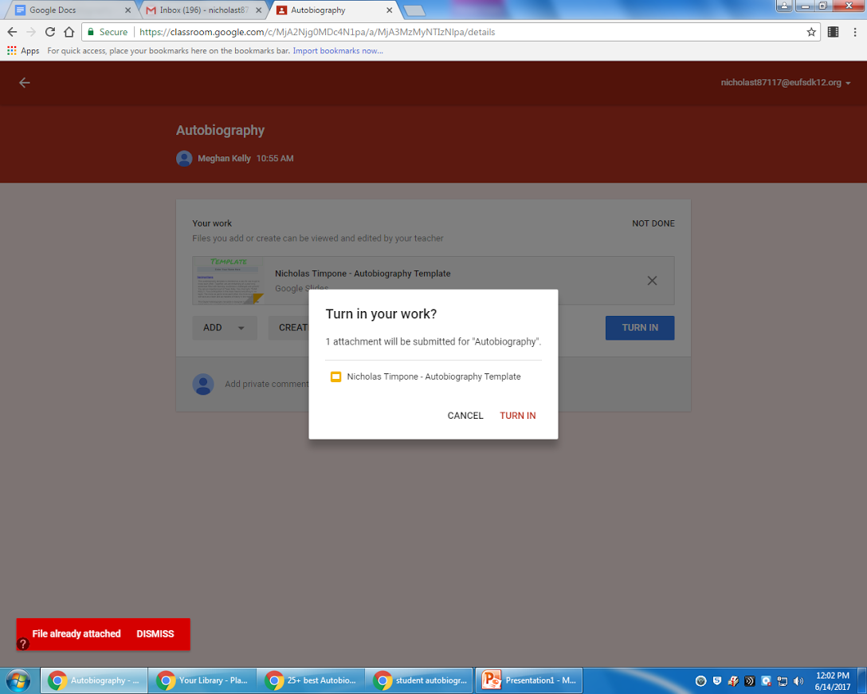
Turn in your work. Make sure that your document is attached!

Slide 23
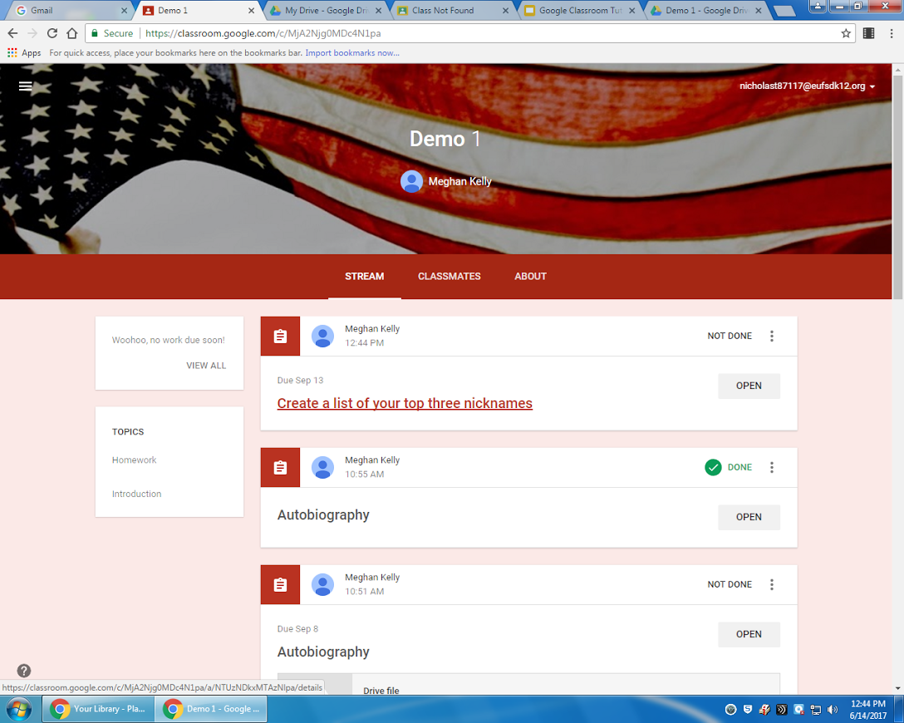
Some of the posted assignments will not have an attached document for you to work on.

Slide 24
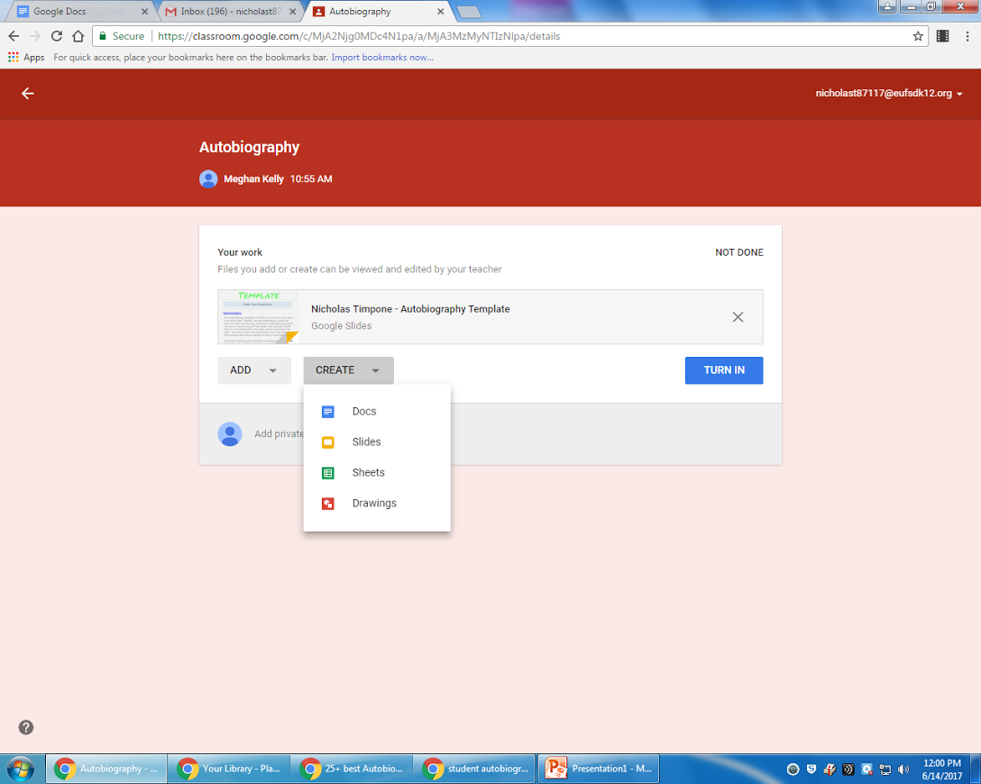
If the assignment does not have an attached document for you to work on, then click “CREATE” and then choose from the type of document that you want to create for the assignment.
You can create the following types of documents:
Docs (word document)
Slides (for presentations)
Sheets
Drawings
Always make sure your title your documents!
Submit the assignment

Slide 25
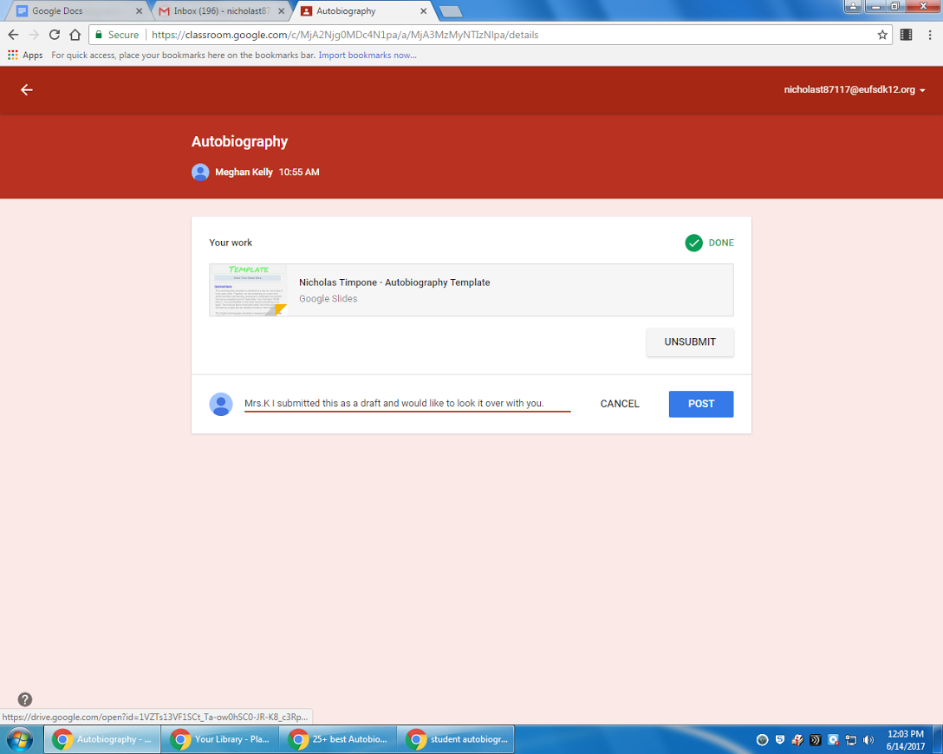
When you have successfully uploaded and turned in your assignment, you will be notified by a:
green check mark: Done

